Slide 1

Analytic Computing
Fachpraktikum
Maritime Anomaly Detection
08.02.2023
Qiuming Li
Zhenhao Xu

Slide 2
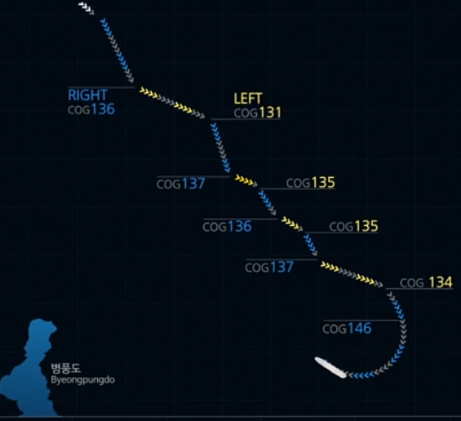
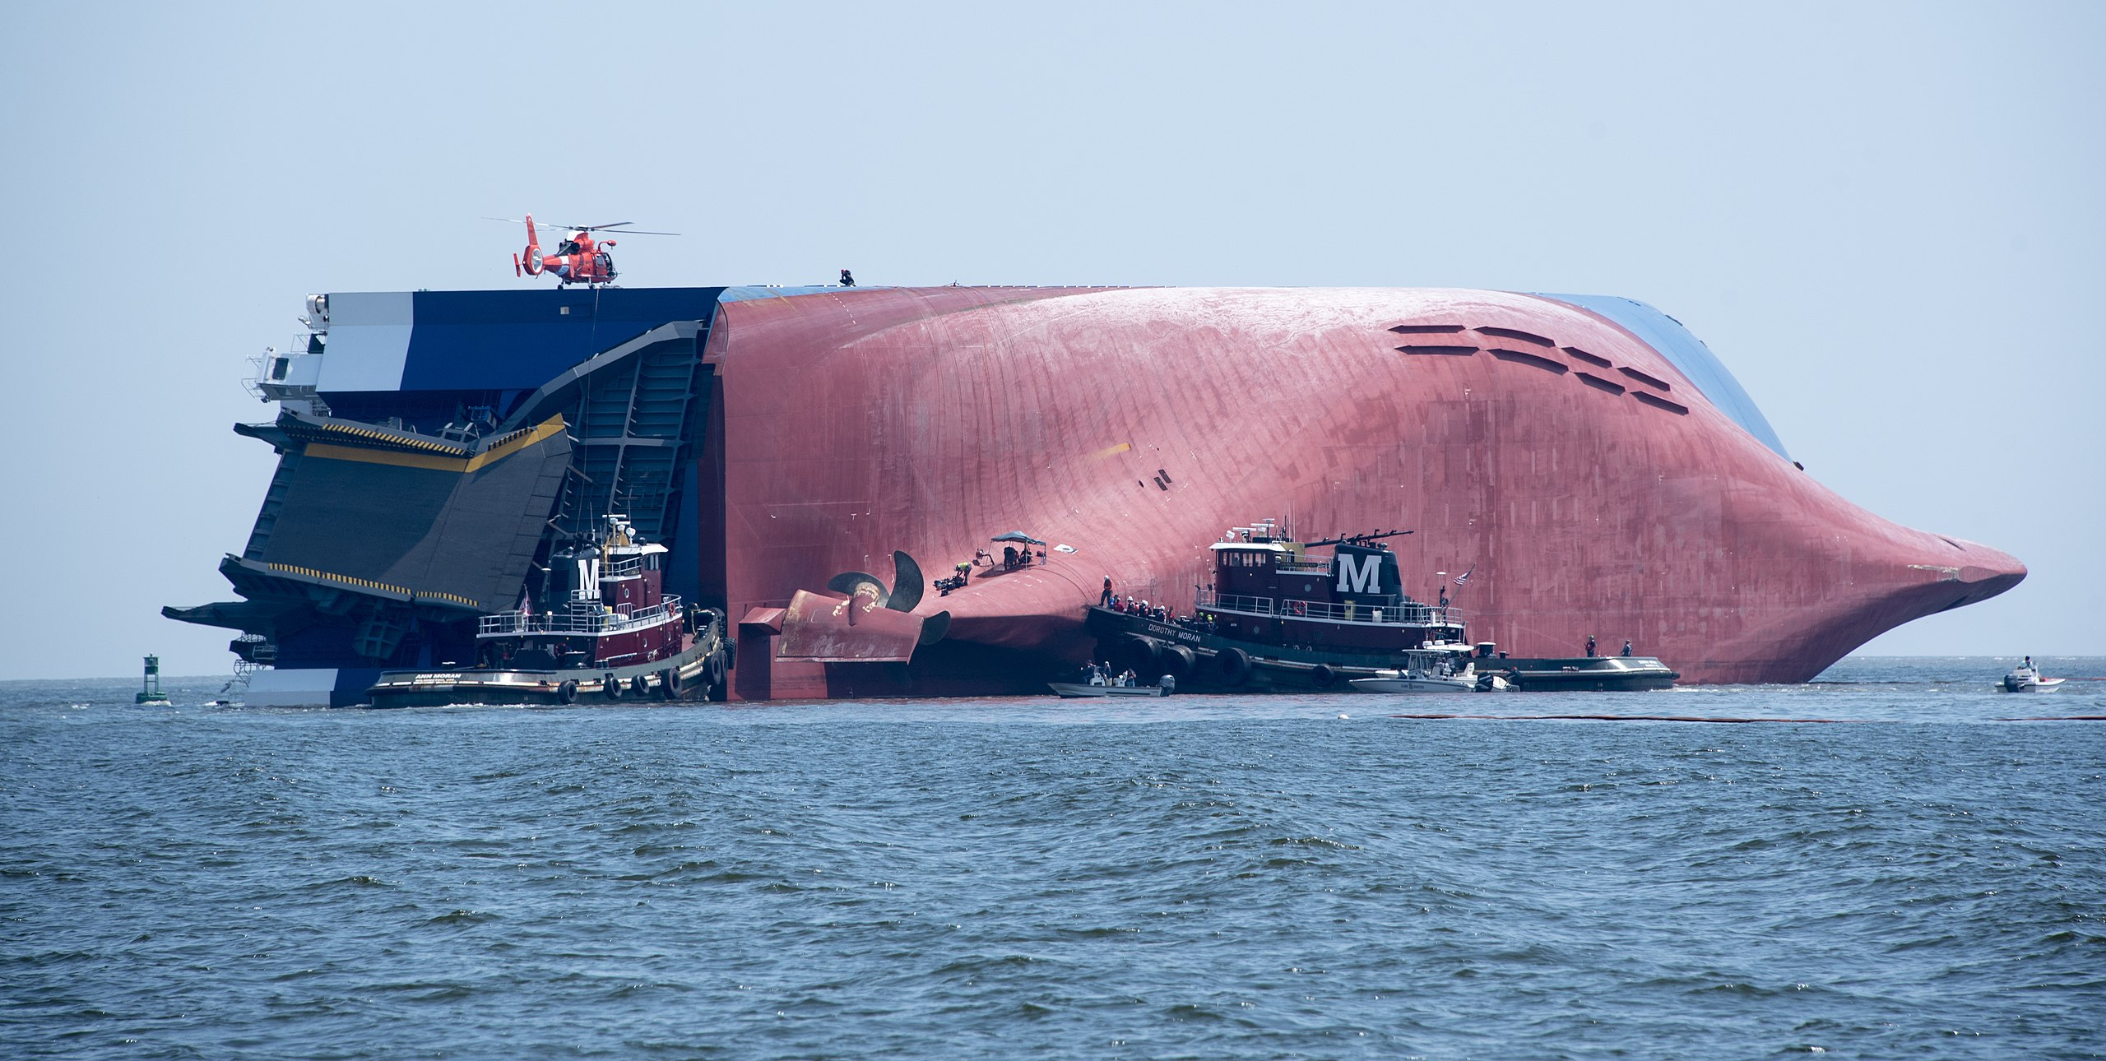
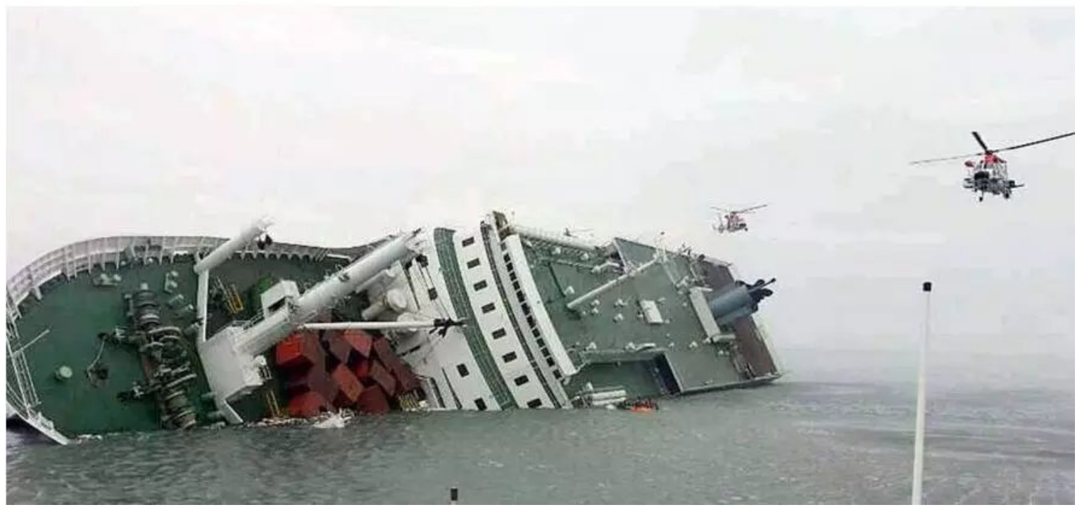
Motivation
MV Golden Ray capsized on 08.09.2019 within the Port of Brunswick's harbor
The ferry MV Sewol sank on the morning of April 16, 2014, an route from Incheon towards Jeju in South Korea, 306 died in the disaster, including around 250 students.
The automatic detection of abnormal behaviour of vessels in ports and sensitive waters and the implementation of early warnings are of great importance in ensuring water traffic safety.

Slide 3
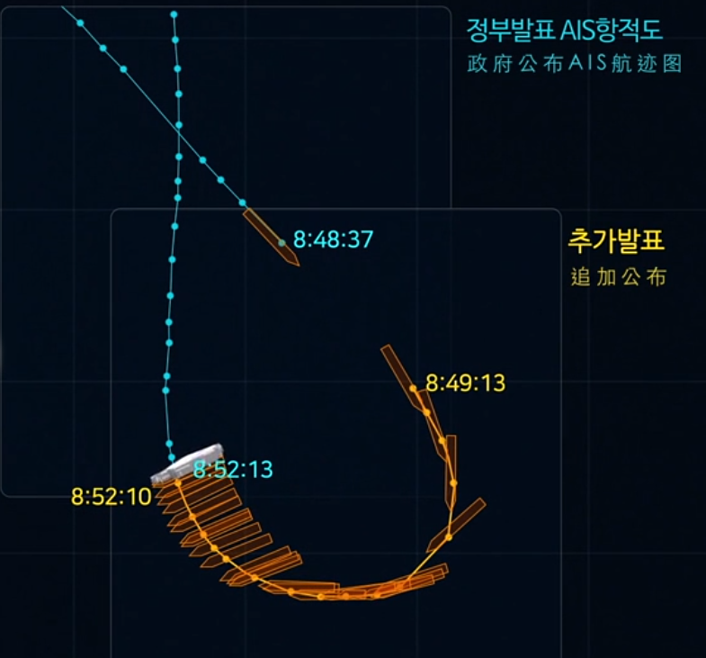

AIS: Automatic Identification System
MMSI | BaseDateTime | LAT | LON | SOG | COG
367369550 | 2019-09-08T00:00:06 | 31.14314 | -81.49662 | 12.3 | 122.8
AIS is an automated, autonomous tracking system that tracks the location of vessels anywhere they are in the world.
MMSI: Maritime Mobile Service Identity, LAT/LON: latitude/longitude
SOG: Speed over Ground, COG: Course over Ground

Slide 4
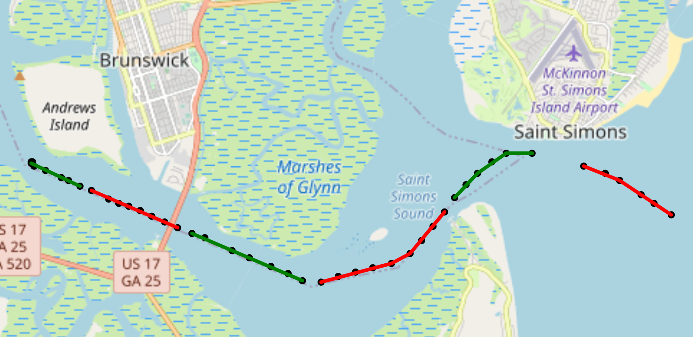
What is our goal？
Our goal is to detect if this segment is anomalous!!
The colour here is only to distinguish the segments
What is segment？
A segment contains the information about a ship's journey over a 10-minute period.
One AIS signal point of one ship per minute can be acquired, but sometimes some signal points may be lost. So in a ten-minute period, we can get up to 10 signal points of a ship.

Slide 5
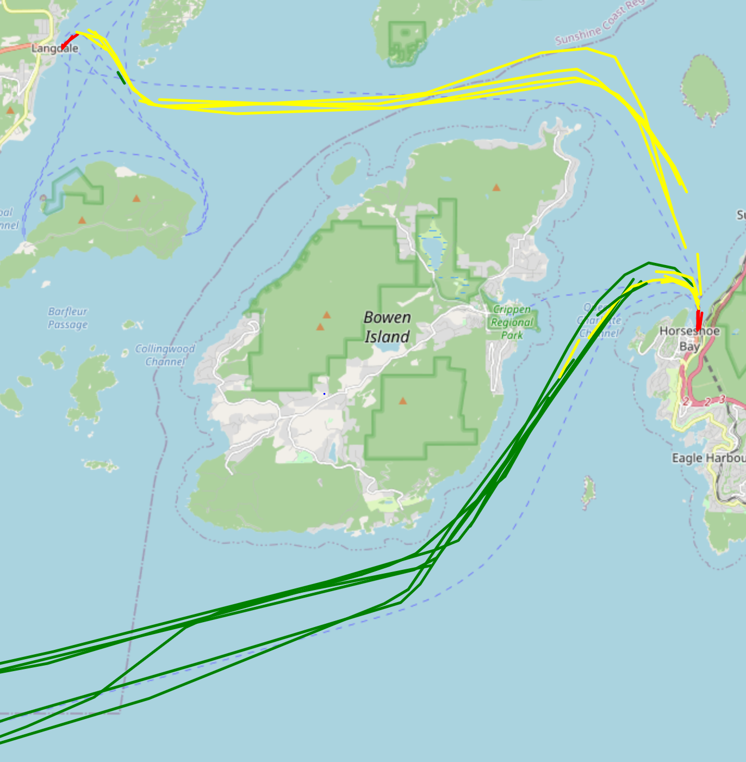
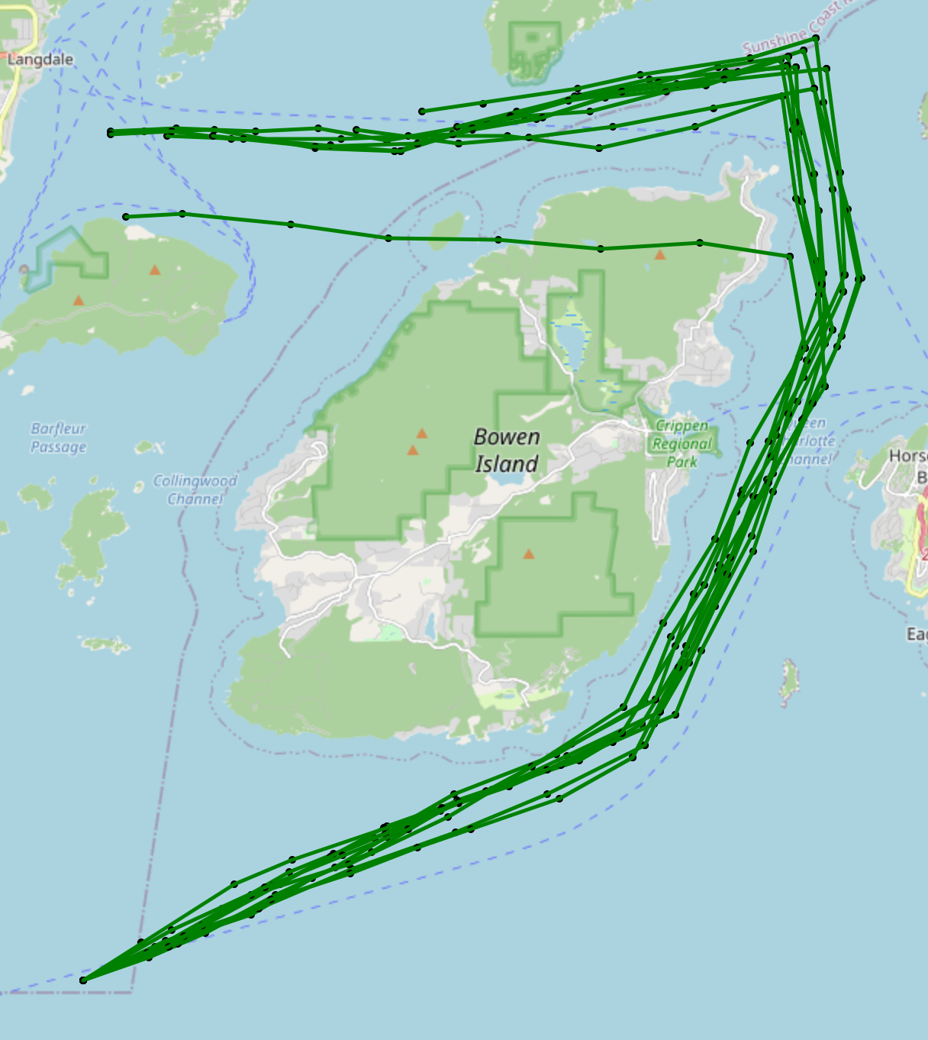
Method: Supervised learning
We use supervised learning to train the model, so we need to set labels for the dataset to distinguish between abnormal and normal data.
Treat all real data as normal
Set up abnormal scenarios and simulate abnormal data
Treat all simulated data as anomalous

Slide 6
Feature Selection
SOG: Speed over Ground
COG: Course over Ground
Distance: Distance between coordinates of two subsequent measurements.
Data
point2
COG
SOG
Difference latitude
Data
point1
Distance
Difference longitude
So we select 3 Features for each time points, and each segment have max. 10 time points. Each segment is represented as an array of shape 10 x 3.

Slide 7
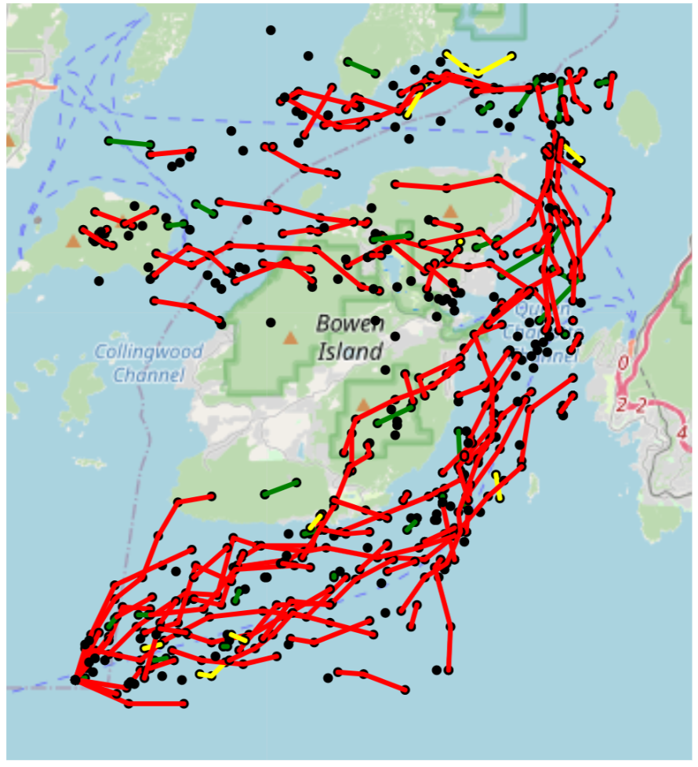
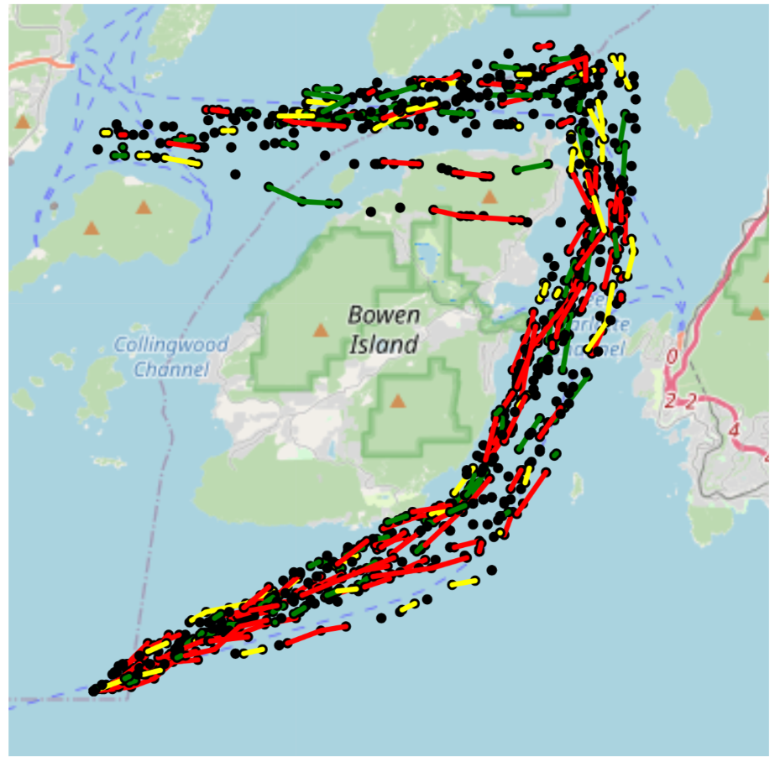
Data Generation
Firstly generate points and then make segments

Slide 8
Data preprocessing
Select Region
Segmentation
N normal segments of shape 10 x 3
Combine as (N+M) x 10 x 3
Model
Real Data
Real Regional Data
M abnormal segments of shape 10 x 3
Abnormal Data Generation
Label each segment as normal/abnormal. Save as (N+M) x 2.

Slide 9
Model: 1D Convolutional Neural Network
Why 1D-CNN Model?
“A 1D-CNN Based Deep Learning Technique for Sleep Apnea Detection in IoT Sensors, (ISCAS) 2021”
“Classification of ECG Signals Based on 1D Convolution Neural Network, (Healthcom) 2017”
The 1D-CNN model is widely used for anomaly detection of time-series data like ECG signals, and AIS signals are also time-series data, so we think it is very appropriate to use the 1D-CNN model
Compared to models such as RNN-based LSTMs, 1D CNNs have the advantage of being fast to train and can be computed in parallel.

Slide 10
CNN-Model structure
Input, shape: 10x3
Convolution 1st layer
Convolution 2nd layer
Max Pooling
Convolution 3rd layer
Max Pooling
Flatten
Dense 1st layer
Dense 2nd layer
Dense 3rd layer
Dense final layer
Output, shape: 1x2

Slide 11
Train/Test Dataset
Train Dataset:
->317 segments real normal data in 2019_01_01 in selected area
->132 segments from random generation abnormal data in selected area
Test Dataset:
->211 segments from real normal data in 2019_06_01 in selected area
->112 segments from random generation abnormal data in selected area
Dataset for real accident test:
->537 segments from real normal and abnormal data in 2019_09_08 in the area the accident happens
->443 segments from real normal and abnormal data in 2019_09_07 in the area the accident happens

Slide 12
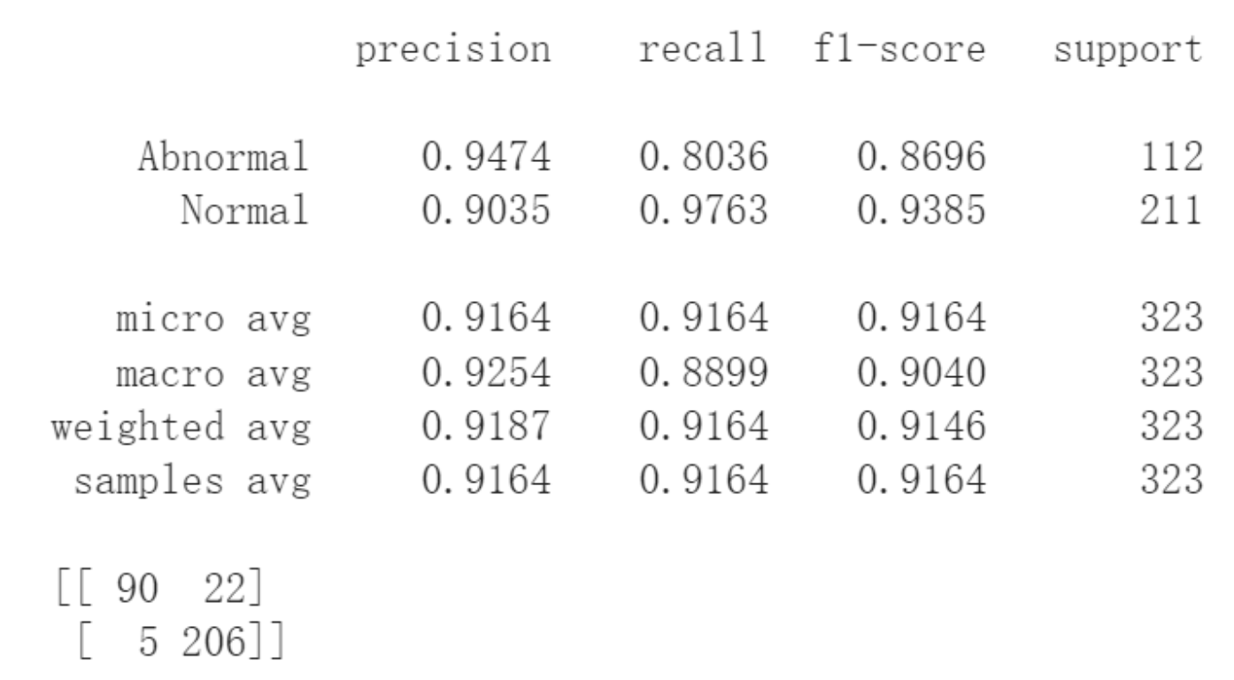
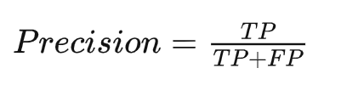
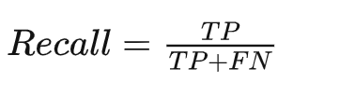
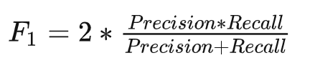
Evaluation
For example:
Confusion Matrix |  | Predicted results
 |  | Negative | Positive
Ground Truth | Negative | True Negative(TN) | False Positive(FP)
 | Positive | False Negative(FN) | True Positive(TP)
For example:
Precision reflects the ability of the model to discriminate between negative samples.
Recall reflects the ability of the model to discriminate between positive samples.
F1 score is a combination of both

Slide 13
CNN-Model1
Results analysis and optimization of models and datasets
We did 7 tests with different models and datasets pairings
Result_1(D1-M1) and Result_2 (D1-M2)
 | Dataset_1
CNN-Model_1 | D1-M1
CNN-Model_2 | D1-M2
CNN-Model2
use 2 features: SOG COG
use 3 features: Distance SOG COG
Dataset_1
If there are missing signals in each segment, supplement missing signals with 0.
But in generation data there is no missing signal

Slide 14
Statistics View of Result_1 (D1-M1) and Result_2 (D1-M2)
Segments in real data:
Segments in generation data:
This is the differences we don‘t want the model to take into account.
One Segment
Signal Point
Missing Signal Point
One Segment
Signal Point
 | Dataset_1 | Dataset_2 | Dataset_3
CNN-Model_1 | D1-M1 | Result_3 | Result_5
CNN-Model_2 | D1-M2 | Result_4 | Result_6

Slide 15
Result_3 (D2-M1) and Result_4 (D2-M2)
 | Dataset_1 | Dataset_2
CNN-Model_1 | D1-M1 | D2-M1
CNN-Model_2 | D1-M2 | D2-M2
Dataset_1
If there are missing signals in each segment, supplement missing signals with 0.
But in generation data there is no missing signals
Dataset_2
If there are less than 3 signals in one segment, drop it. otherwise supplement missing signals with 0
And in generation dataset there is random missing signals and supplement with 0
One Segment in generation data
Signal Point
Randomly add missing signal points

Slide 16
Statistics View of Result_3 (D2-M1) and Result_4 (D2-M2)
The model cannot simply distinguish between real and generated data by the number of missing signals in the segment
But there is too little Information in each segment.
 | Dataset_1 | Dataset_2 | Dataset_3
CNN-Model_1 | D1-M1 | D2-M1 | Result_5
CNN-Model_2 | D1-M2 | D2-M2 | Result_6

Slide 17
Result_5 (D3-M1) and Result_6 (D3-M2)
 | Dataset_1 | Dataset_2 | Dataset_3
CNN-Model_1 | D1-M1 | D2-M1 | D3-M1
CNN-Model_2 | D1-M2 | D2-M2 | D3-M2
Dataset_1
If there are missing signals in each segment, supplement missing signals with 0.
But in generation data there is no missing signals
Dataset_2
If there are less than 3 signals in one segment, drop it. otherwise supplement missing signals with 0
And in generation dataset there is random missing signals and supplement with 0
Dataset_3
If there are less than 5 signals in one segment, drop it. otherwise supplement missing signals with 0
And in generation dataset there is random missing signals and supplement with 0

Slide 18
Statistics View of Result_5 (D3-M1) and Result_6 (D3-M2)
 | Dataset_1 | Dataset_2 | Dataset_3
CNN-Model_1 | D1-M1 | D2-M1 | D3-M1
CNN-Model_2 | D1-M2 | D2-M2 | D3-M2

Slide 19
Statistics View of Result_6 (D3-M2) and Result_7 (D3-SVM)
Performance of CNN-Model is better than SVM-Model
 | Dataset_3
CNN-Model_1 | D3-M1
CNN-Model_2 | D3-M2
SVM-Model | D3-SVM

Slide 20
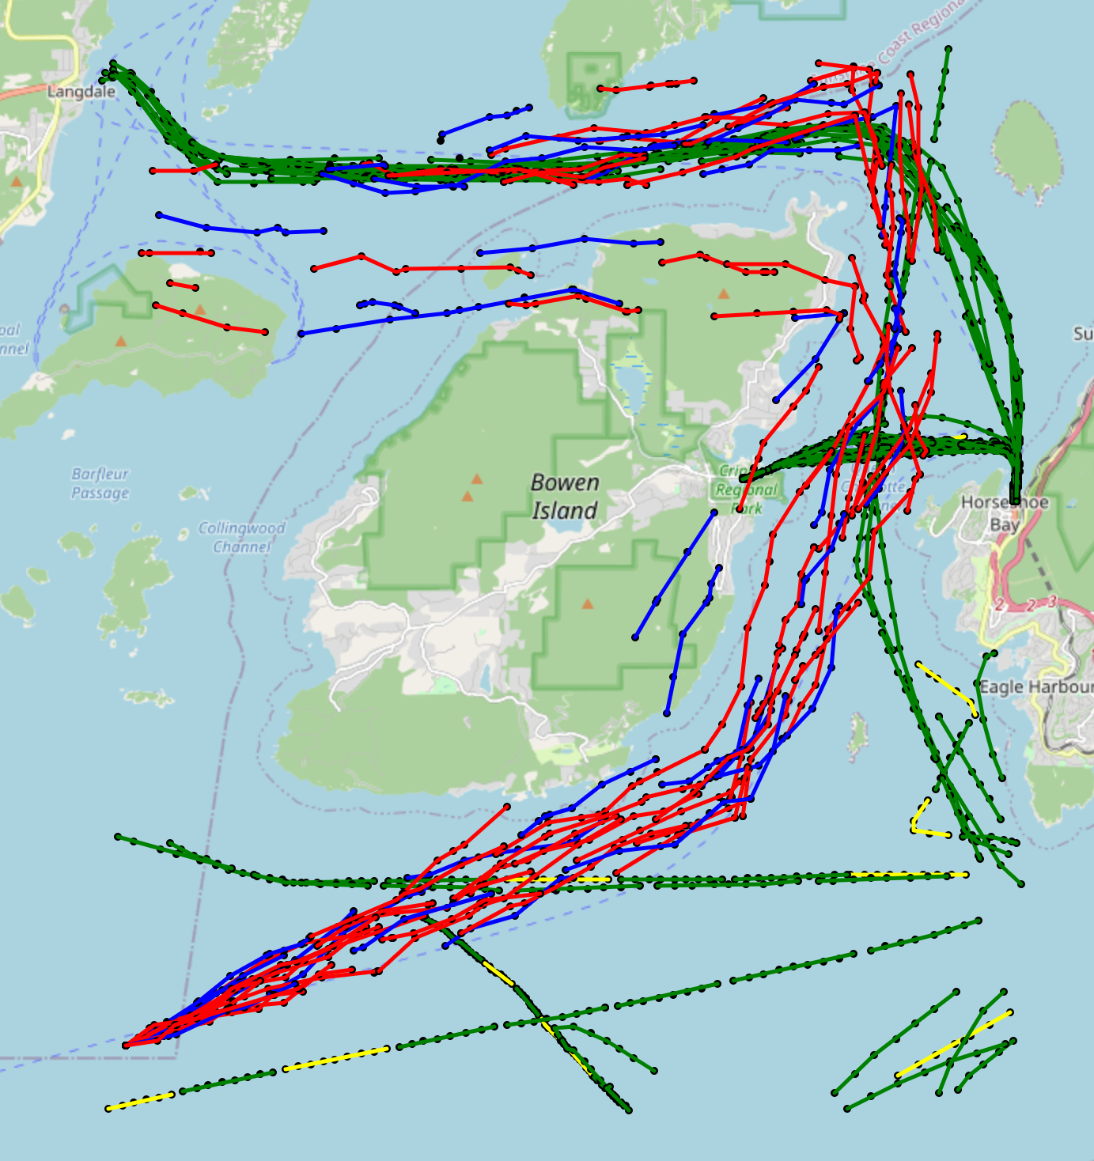
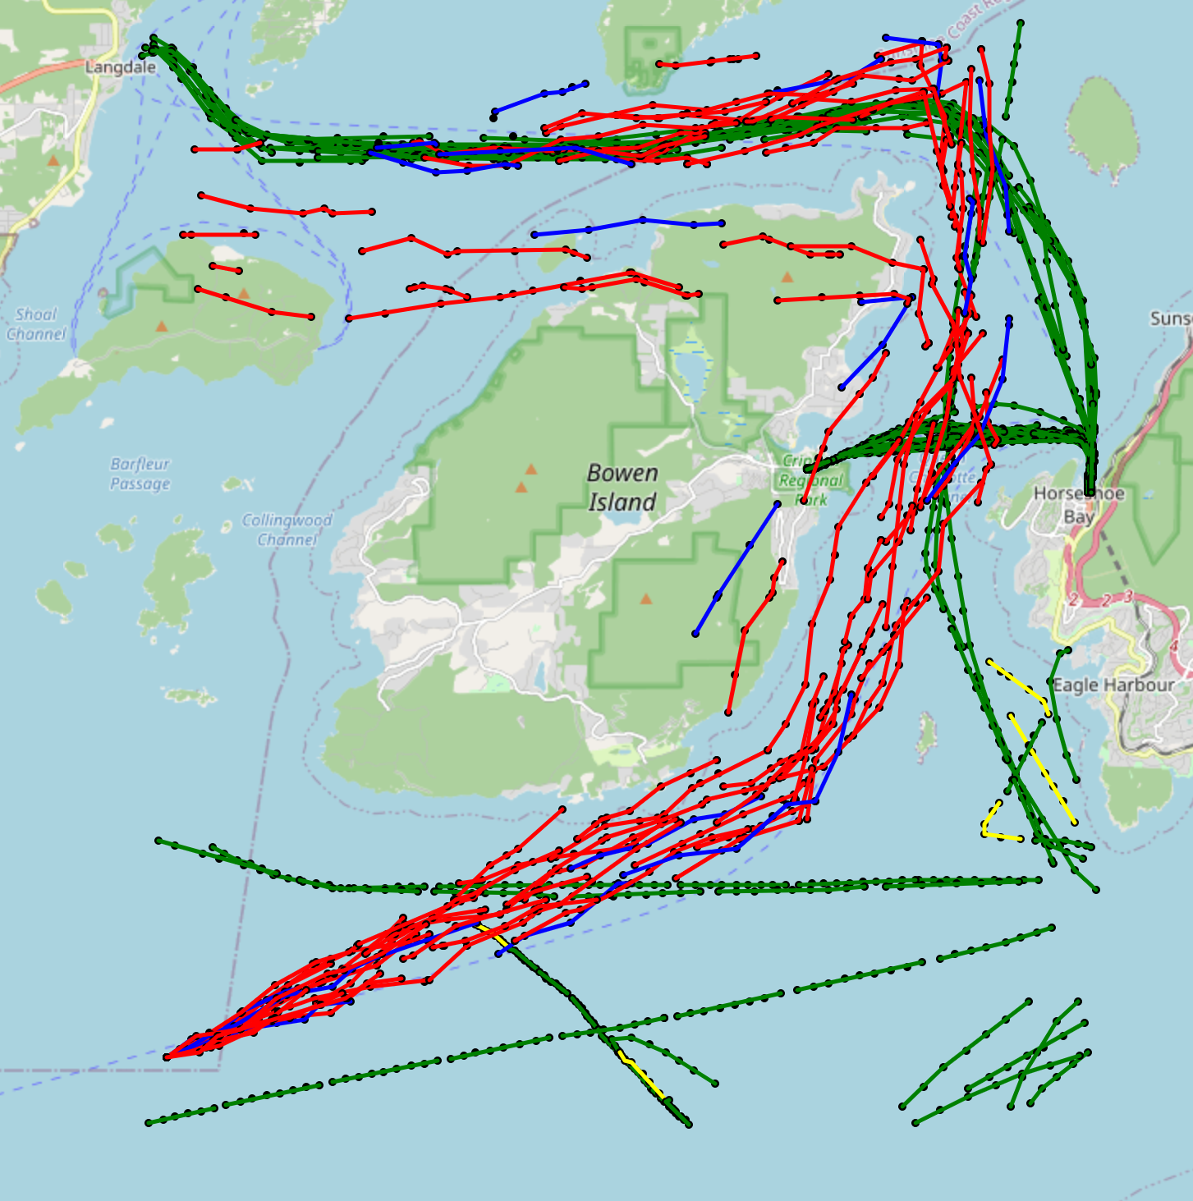
Map View of Results
 | Predicted Negative | Predicted Positive
Actual Negative | Red (TN) | Blue (FP)
Actual Positive | Yellow (FN) | Green (TP)
M1-D3(use 2 features)
M2-D3(use 3 features)

Slide 21
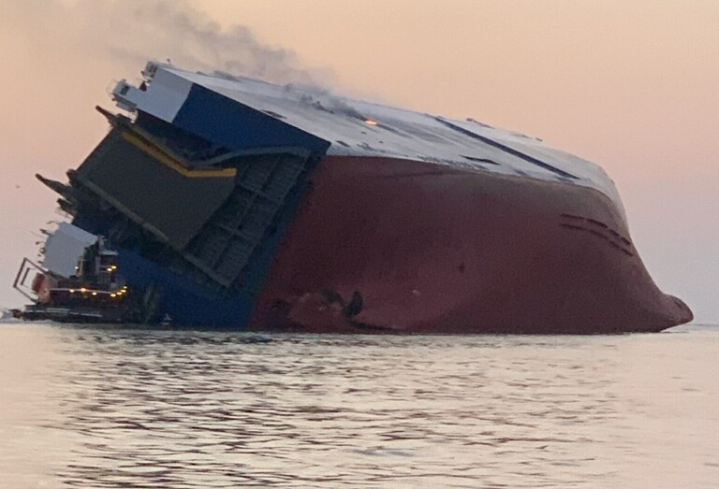
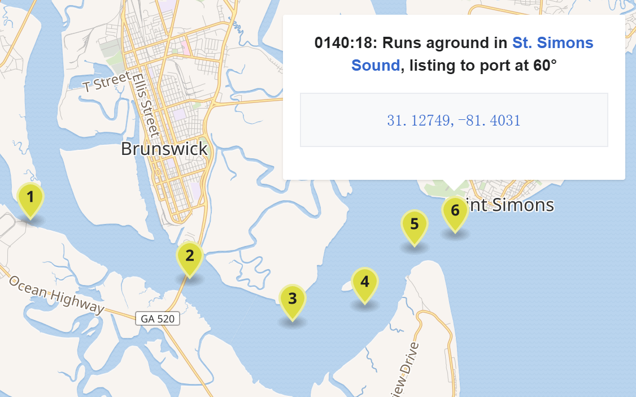
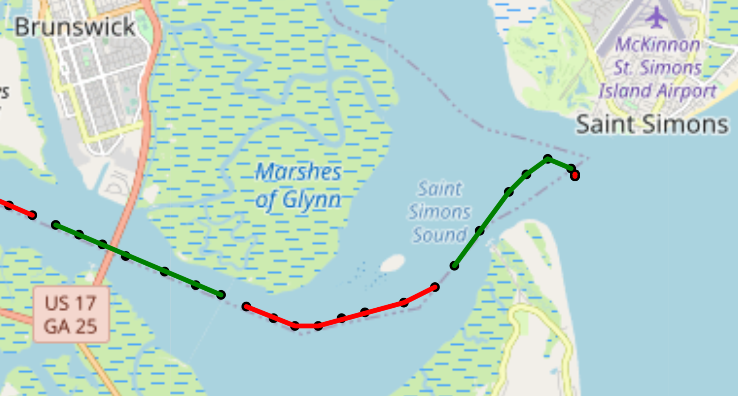
Real accident test
Real accident description：The MV Golden Ray was a 200-metre long (660 ft) roll-on/roll-off cargo ship，On 8 September 2019 at approximately 0137 EDT, the Golden Ray capsized within the Port of Brunswick's harbor, shortly after unberthing and proceeding towards the Port of Baltimore.
Wikipedia's reliable information on the location of the incident:
AIS data of the ship at the time of the incident that we found in the dataset:
The colour here is only to distinguish the segments

Slide 22
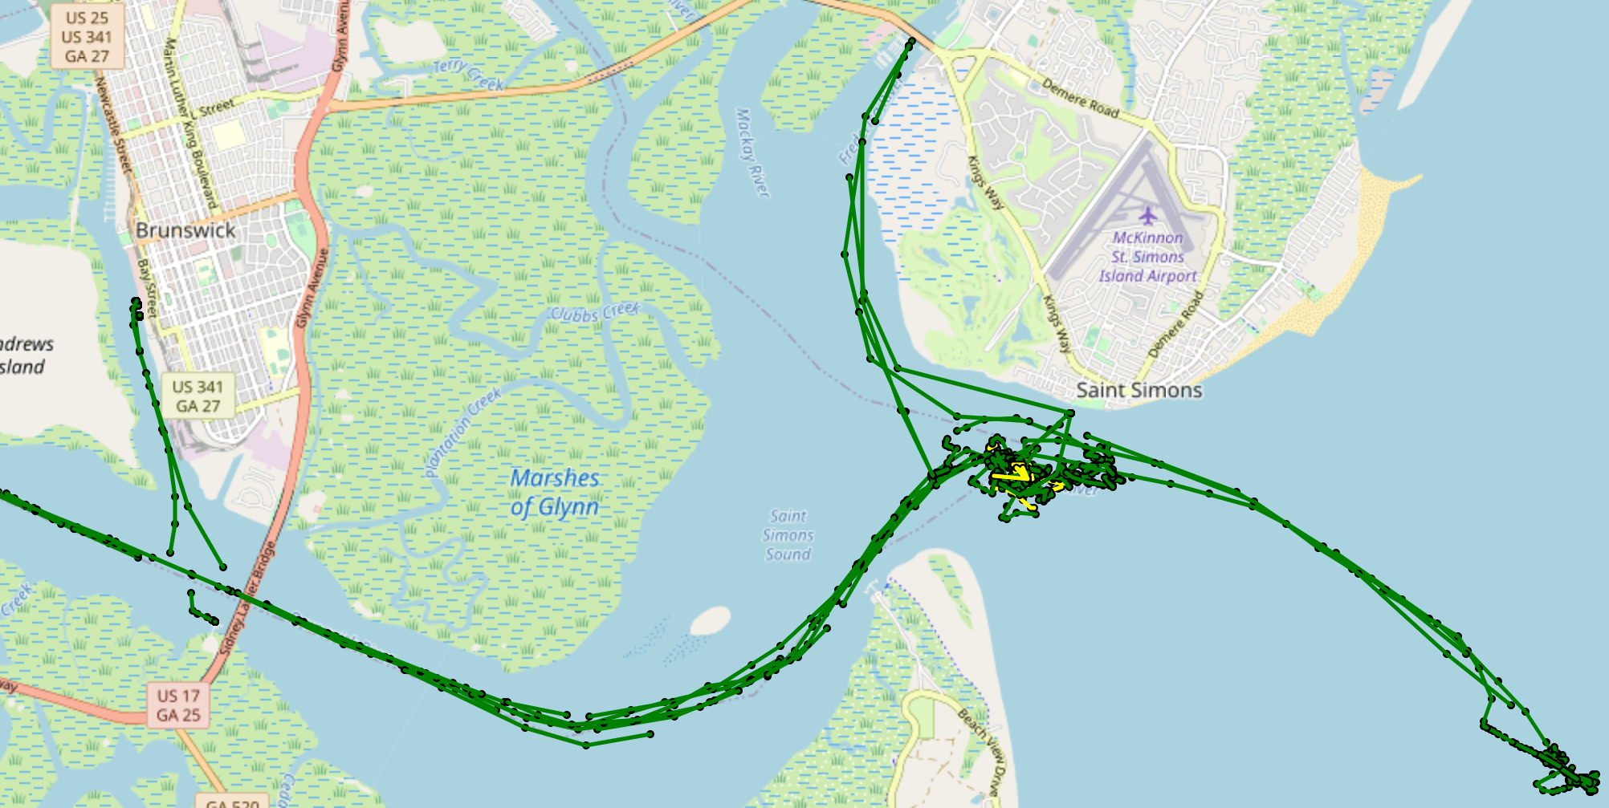
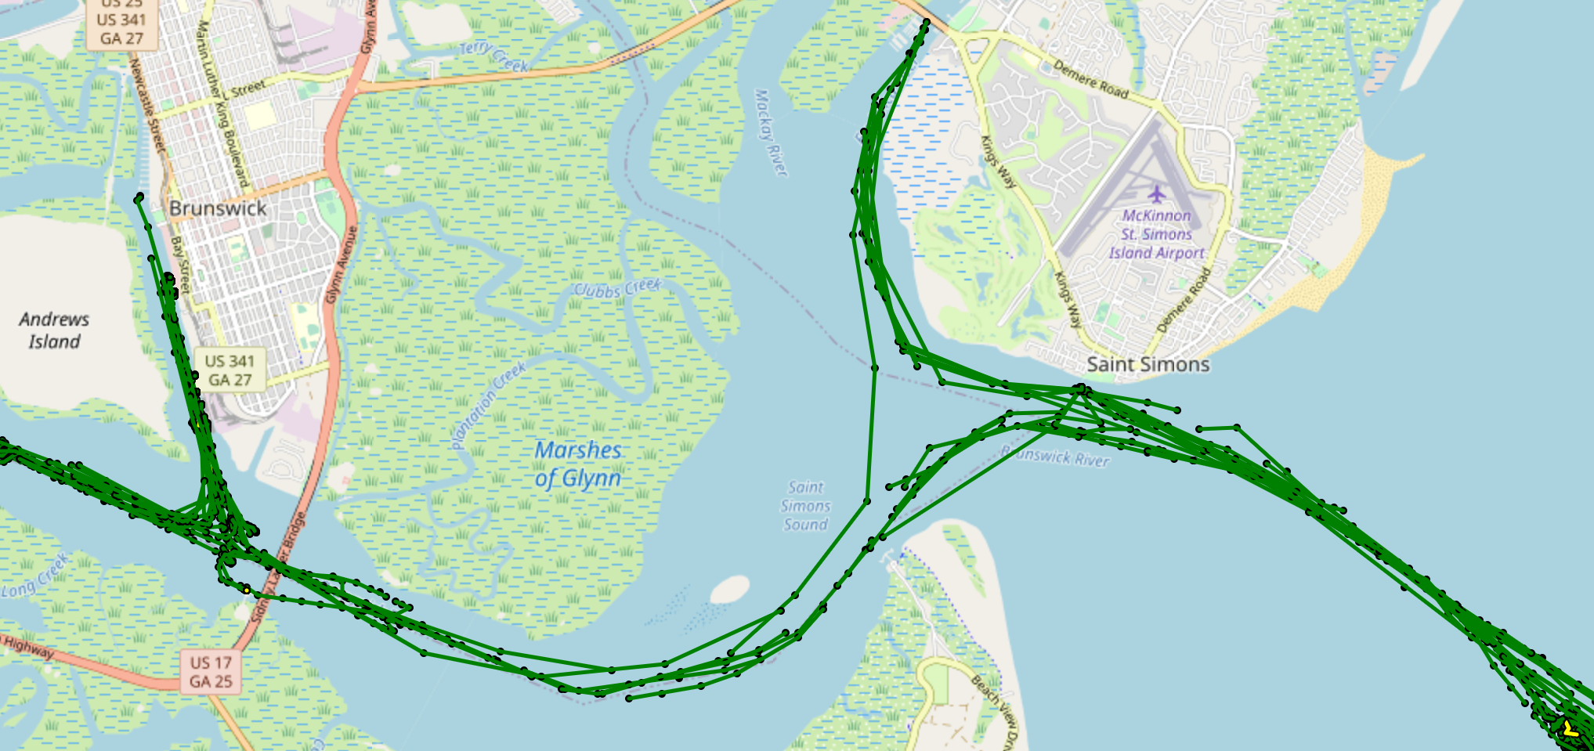
Performance of the Model Predict for real accident
Results from the Day of accident: 08.09.2019
Wikipedia's reliable information on the location of the incident:
Location of the incident!
Result from the Day before accident: 07.09.2019
 | Abnormal | Normal
Predict | Yellow | Green

Slide 23
What problems did we solve?
Our model can detect anomalous speed changes or directional changes of a vessel during a certain time period.
So if a accident is because of anomalous speed changes or directional changes,
After the accident, we can detect the accident by analyzing the AIS data.
But the model cannot predict accidents that do not occur.

Slide 24
What is still lacking?
Due to the limitations of the data generation method, only anomalous changes in speed and direction can be identified
Solution: Find more realistic anomalous events or artificially set up more anomalous scenarios and simulate anomalous data based on them.
If the accident occurs between two segments, this accident is ignored by the model
Solution: Cut segments in different ways for the same trajectory so that different segment data can be generated for data enhancement.
For a more diverse set of anomalies, three features are not enough
Solution: Leverage features in AIS data and combine them with geographic information

Slide 25

Q&A

Slide 26
Contents
1. Motivation
2. Basic Information
3. Goal and Basic Ideas
4. Features Selection
5. Data Generation
6. Date Preprocessing
7. Model Selection
8. Train/Test Dataset
9. Evaluation
10. Results Analysis and Optimization of models and datasets
11. Real accident test
12. Ideas for improvement

Slide 27
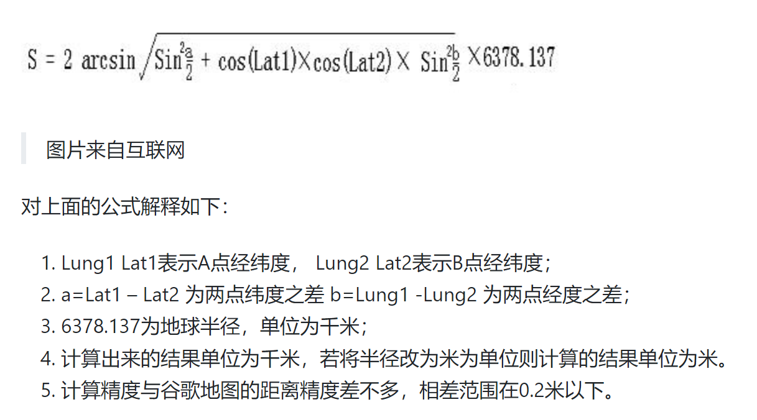

Slide 28
Model1
9. Optimization of models and datasets
1. use 2 features: SOG COG
Model2
1. use 3 features: Distance SOG COG
Dataset1 (Overfitting?)
1. if there are less than 10 time point in one segment, Supplement missing signals with 0
2. no missing data in generation dataset
Dataset2 (too little information?)
1. if there are less than 3 time point in one segment, drop it. otherwise supplement missing signals with 0
2. random missing data(at least 3 time point rest) in generation dataset, and supplement with 0
Dataset3 (the best)
1. if there are less than 5 time point in one segment, drop it. otherwise supplement missing signals with 0
2. random missing data(at least 5 time point rest) in generation dataset, and supplement with 0
Dataset4(just try)
1. All same as Dataset3 but the generation data seems like more unreal

Slide 29
10.1 Statistics View of results
 | Dataset_1 | Dataset_2 | Dataset_3
Model_1 | Result_1 | Result_3 | Result_5
Model_2 | Result_2 | Result_4 | Result_6

Slide 30
10. Comparing the performance of different models
10.1 Statistics View of results
 | Dataset_1 | Dataset_2 | Dataset_3 | Dataset_4
Model_1 | Result_1 | Result_3 | Result_5 | Result_7
Model_2 | Result_2 | Result_4 | Result_6 | Result_8

Slide 31
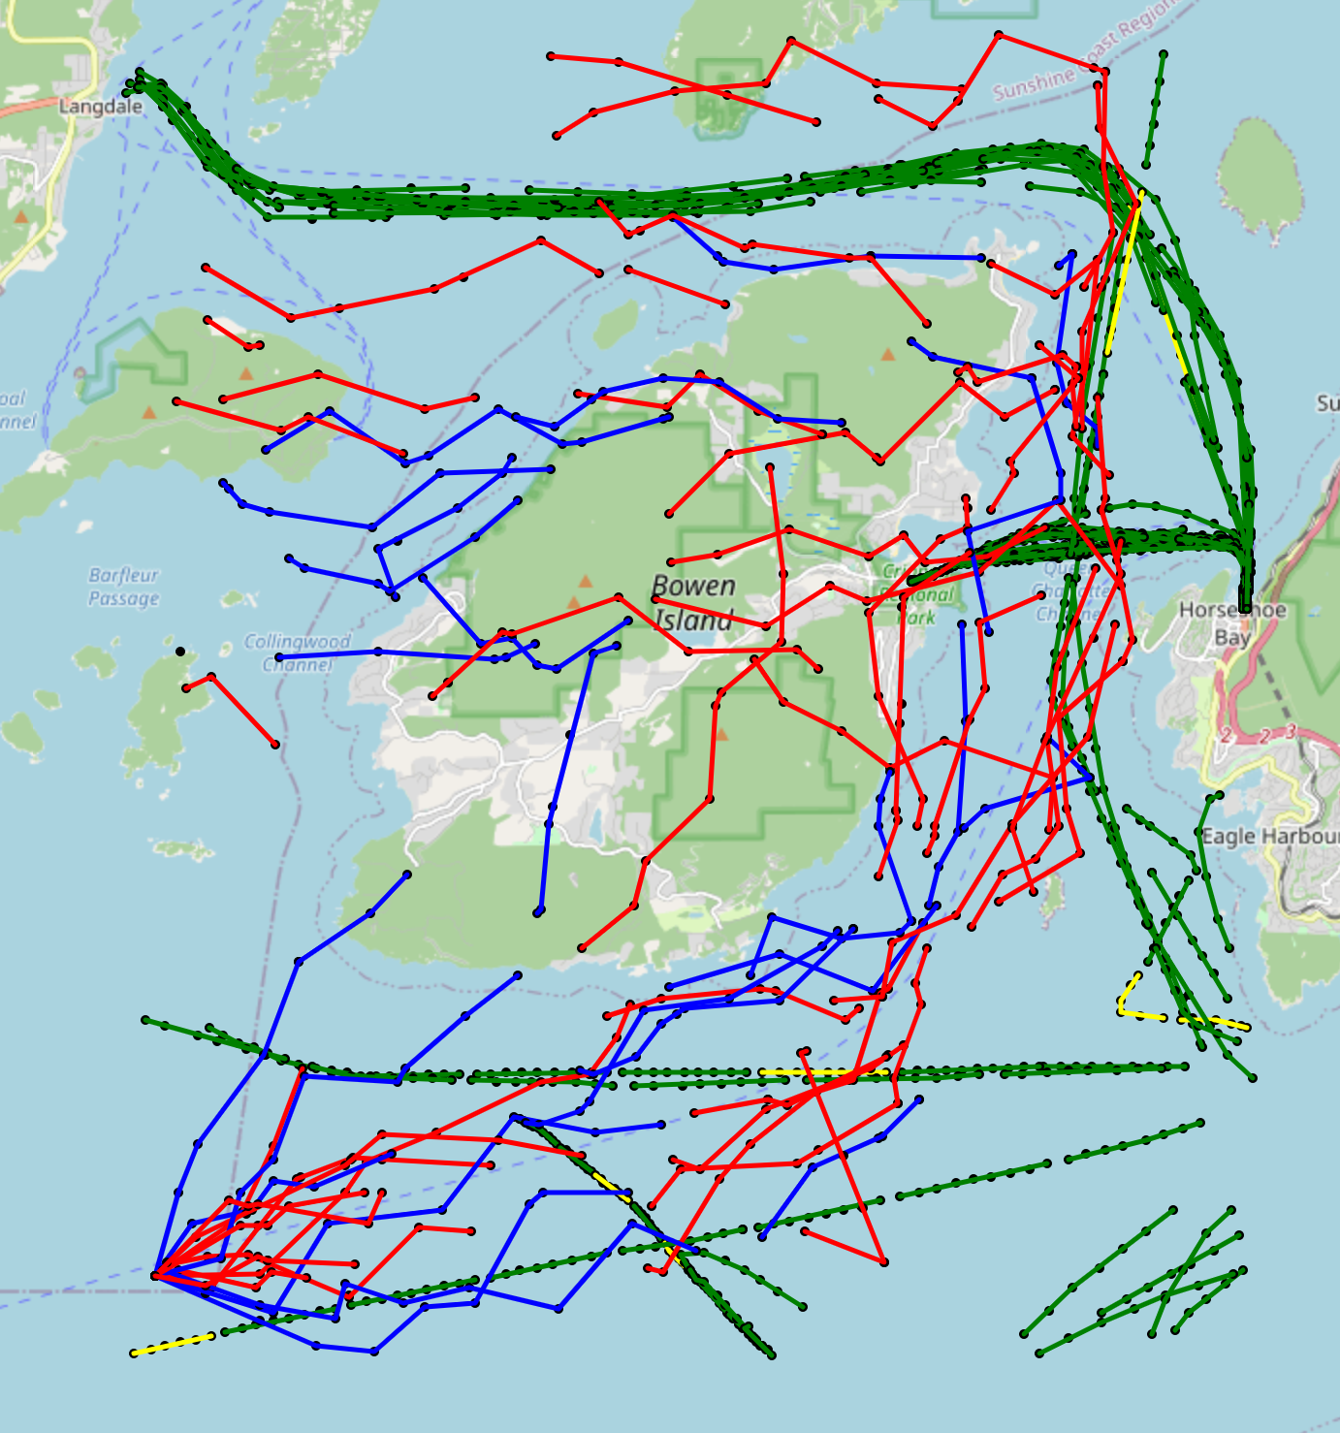
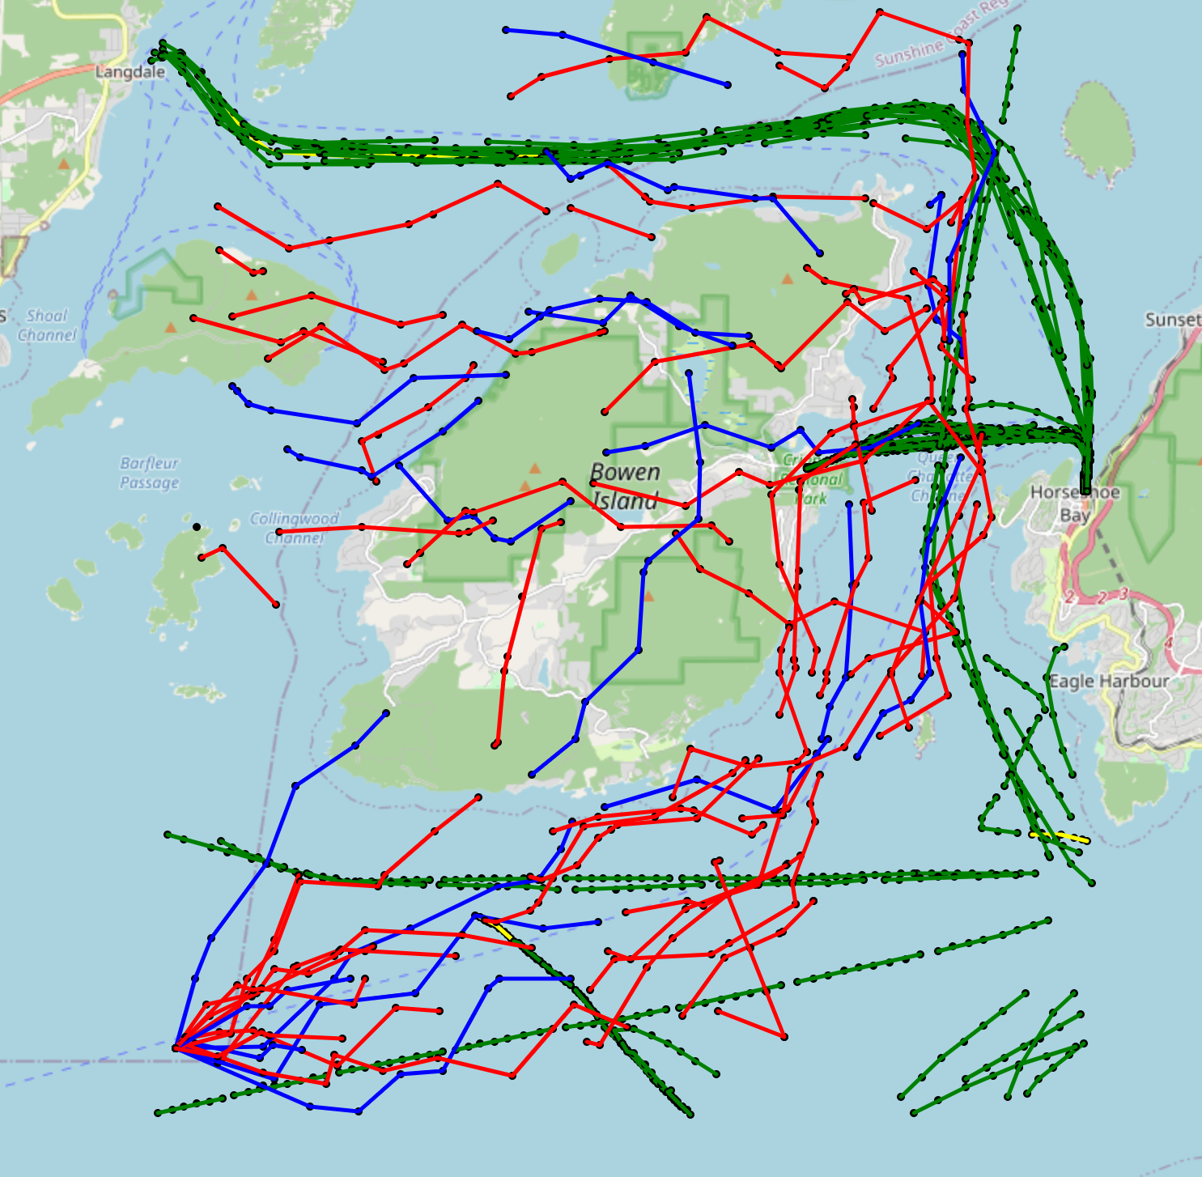
10.2 Map View of results
Result 7
Result 8

